Slide 1
Quantifying the Predictive Power of Biological vs. Environmental Features in Health Outcomes
ISA 530: Final Project
Carly Carroll

Slide 2

Introduction
Adult health outcomes are shaped by both biological predispositions and lived experiences
General datasets confound genes with environment, making it difficult to isolate effects
Twin designs allow control of shared genetics and early life environment
Enables stronger inference on environmentally driven health divergence
Machine learning can be used to examine structure, prediction, and change over time
Notes:
Health ≠ genetics alone → lived experience matters
Most datasets mix biology + environment → confounding
Twins control for genes + early upbringing
Differences later in life → more likely environmental
ML lets us compare patterns, prediction, and change

Slide 3
Literature Review
Predictive Power of Self Rated Health
Moderate Genetic Influence
Self rated health reliably predicts morbidity and mortality, capturing meaningful variation in overall health status
Twin studies show health outcomes are partially heritable, but shared biology does not fully determine adult health trajectories
Environmental Accumulation Across Adulthood
Gaps in the Literature
Life course and accumulated disadvantage show behavioral and socioeconomic exposure compound and drive divergence over time
Few studies combine twin design and machine learning to directly compare biological vs. environmental predictive strength across adulthood
Notes:
SRH validated as strong proxy for real health outcomes
Heritability explains baseline, not life-course divergence
Life-course theory → cumulative exposure over time
Social determinants persist beyond early life
Gap: limited ML work using twin designs

Slide 4

Data Description
Data Source: MIDUS Twin Sample
(national longitudinal health study)
Includes adult twins followed across multiple waves (~10 year intervals)
Allows for pairwise comparison and tracking of change over adulthood
Sample size includes 1,516 individual participants, 758 twin pairs
Domain | Variables
Biological | BMI, Diabetes, Asthma, Hypertension, Depression
Environmental | Education, Household Income, Exercise, Smoking, Alcohol Use, Marital Status
Notes:
MIDUS = national, longitudinal adult health study
Focus on twin subsample for within-family control
Three waves → midlife to later adulthood
Mix of biological, behavioral, socioeconomic features
Enables cross-sectional + longitudinal analysis

Slide 5
Data Preprocessing
Data Cleaning
Data Merging
Verified and retained complete pairs only ensures valid within pair inference
Wide: Each wave stored in separate columns used for cross sectional comparisons
1
1
Standardized continuous variables using scaling allows for comparability across models
Long: Observations stacked by wave
used for longitudinal modeling of change over time
2
2
Applied median imputation handles missing biological and environmental variables
Diffs: Calculated Twin B - Twin A values isolates environmental divergence while holding genetics constant
3
3
Notes:
Different data structures for different questions
Wide → baseline comparisons
Long → repeated measures over time
Differences → isolate non-shared influences
Scaling needed for fair coefficient comparison

Slide 6
Research Questions
Baseline vs.
Divergence
Within Pair Health Difference
Changes Across Adulthood
To what extent do biological and environmental factors each contribute to variation in self rated health?
When genetically similar individuals diverge in health, are those differences better explained by biological factors or by environmental exposures?
Does the relative influence of biological vs. environmental factors shift across the lifespan, particularly as individuals age?
Notes:
Which factors best explain adult SRH variation?
Do twins diverge biologically or environmentally?
Can divergence be predicted within pairs?
Do effects strengthen or weaken with age?

Slide 7

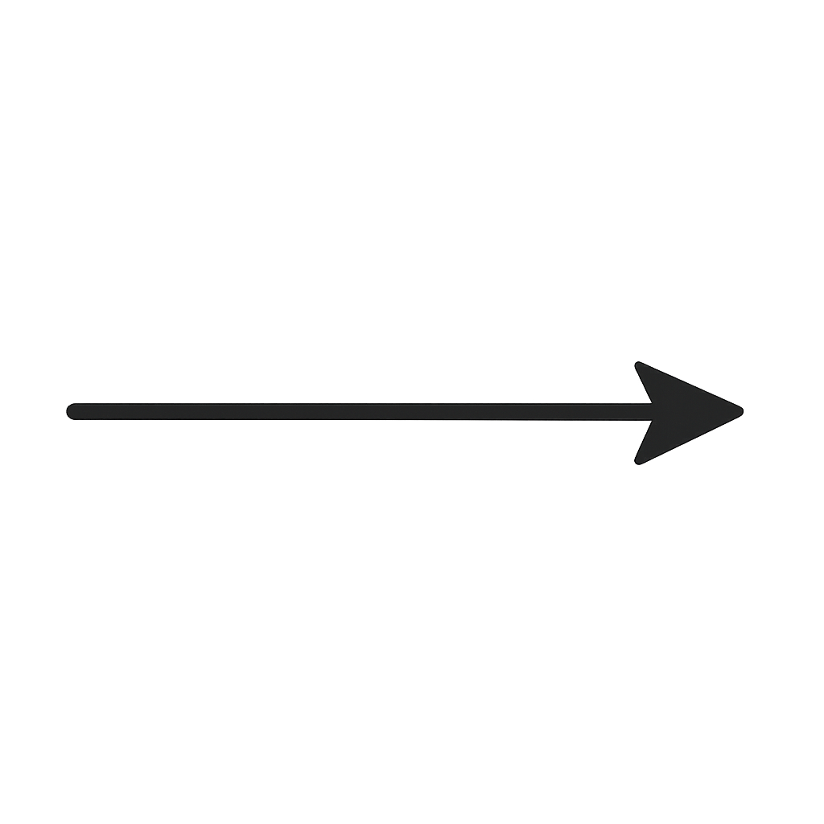
Methodology
Unsupervised Learning
Principal Component Analysis
K-Means Clustering
Within Pair Supervised
Support Vector Machine
Population Level Supervised
Logistic Regression
Gradient Boosted Decision Trees
Longitudinal Modeling
Longitudinal Mixed Effects Model
Notes:
Each model answers a distinct question
Unsupervised → structure, similarity
Supervised → prediction, importance
Longitudinal → variance + change over time
Converging evidence across methods

Slide 8

Unsupervised Learning
Goal: Examine how biological vs. environmental features are structured in the population
Two analytical components:
PCA reduces dimensionality and reveals major axes of variation
K-Means identifies natural grouping patterns
Twin pair overlays visualize within pair similarity and divergence
Interpretation focuses on structure, not prediction
Helps determine which variable set differentiates individuals more strongly
Notes:
No outcome used at this stage
Goal: see natural organization of features
PCA → dominant dimensions
Clustering → similarity groupings
Twin overlays → divergence vs similarity

Slide 9
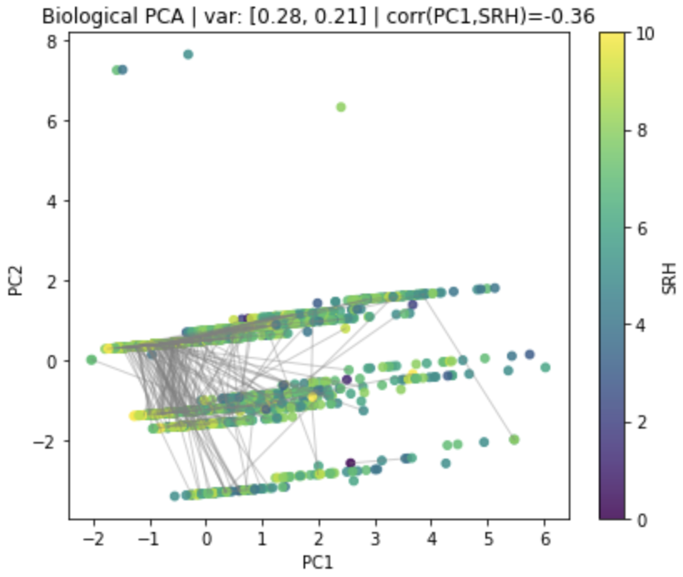
Biological Principal Component Analysis
PC1 reflects chronic disease burden
PC2 reflects depressive and respiratory problems
Twin points are tightly clustered _
high biological similarity
Limited within pair variation across adulthood
Suggest biology forms a shared baseline
Notes:
PC1 captures overall disease burden
PC2 reflects mental / respiratory health
Twins cluster tightly in PCA space
Short connecting lines → biological similarity
Supports shared physiological baseline

Slide 10
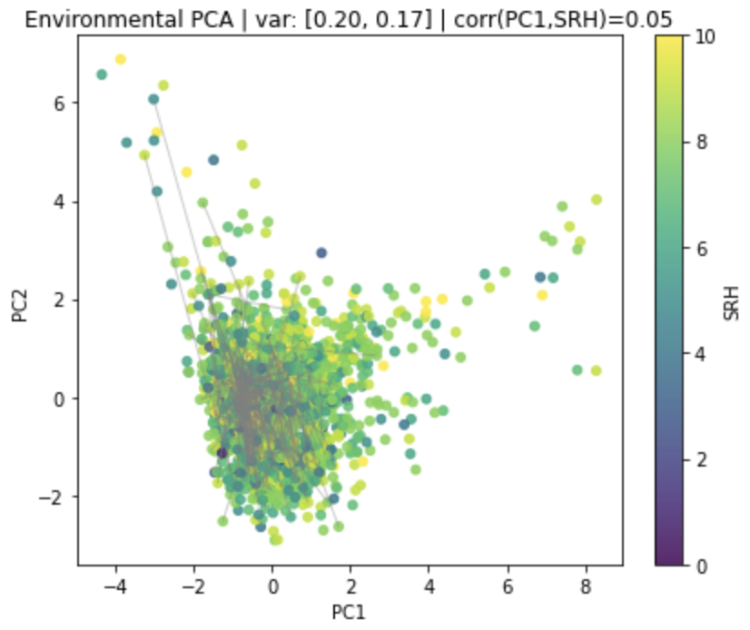
Environmental Principal Component Analysis
Lower explained variance
more complex and diverse experiences
Twin pairs show wider separation in PCA space
Reflects life course environmental divergence
Suggest environment shapes individual differentiation
Notes:
Lower variance explained → more heterogeneity
Environmental exposures not one-dimensional
Twin separation noticeably larger
Reflects accumulated lived experience
Environment differentiates over adulthood

Slide 11
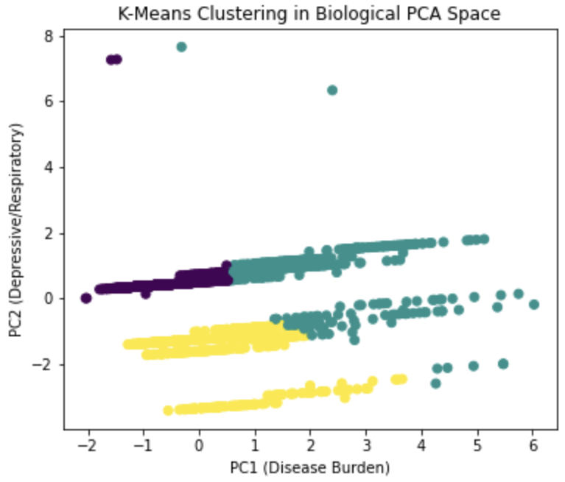
Biological Clustering Analysis
Clusters captured variation in chronic disease burden
Cluster cohesion is moderately high (silhouette = 0.59)
54% of twin pairs assigned to the same biological cluster
Suggest stable, shared physiological health baseline across adulthood
Notes:
Clusters align with health risk profiles
Reasonable cohesion (silhouette score)
Many twins assigned same cluster
Suggests biological stability
Reinforces baseline interpretation

Slide 12
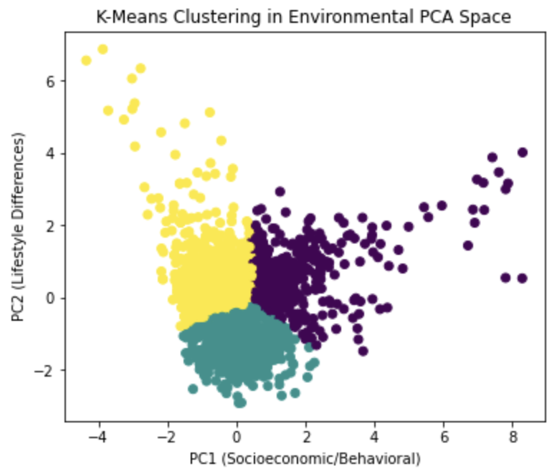
Environmental Clustering Analysis
Greater dispersion and less cluster cohesion (silhouette = 0.41)
59% of twin pairs fell into the same environmental cluster
Indicates accumulated divergence in lived experiences
Environmental variation is less structured than biology
Patterns reflect individualized environmental pathways
Notes:
Weaker cluster separation
Greater within-cluster variability
Twins often split across clusters
Environment less structured than biology
Indicates diffuse accumulation

Slide 13
Supervised Learning
Goal: Predict self rated health and evaluate the relative influence of biological vs. environmental factors
Modeling frameworks:
Within Pair SVM isolates environmental divergence
Logistic Regression estimates direction and magnitude of predictor effects
Gradient Boosted Decision Trees models nonlinear relationships
Evaluation emphasizes accuracy, AUC, and feature importance
Compare predictive contributions of biological vs. environmental domains
Notes:
Shift from structure → prediction
SRH as outcome variable
Compare model performance + interpretability
Linear vs nonlinear approaches
Within-pair vs population-level modeling

Slide 14
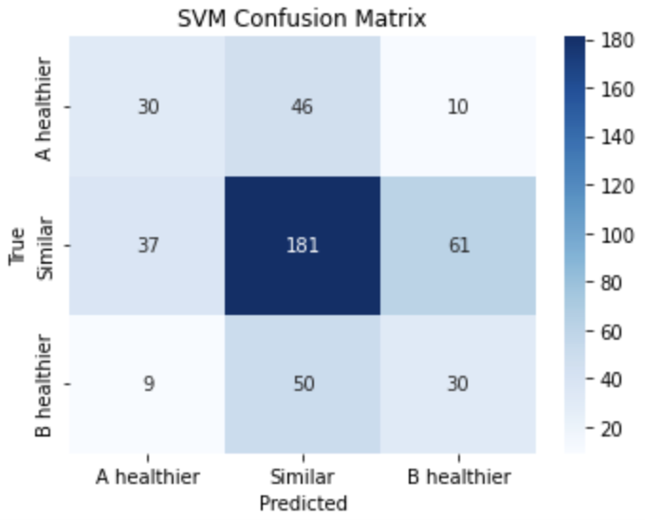
Support Vector Machine
Predicts which twin reports higher SRH using within pair differences
Most twin pairs showed minimal difference shared health baseline
When SRH does diverge, differences are subtle and noisy
Within pair differences captured non-shared environmental and behavioral factors
Accuracy = 0.53, F1 = 0.45 (modest performance)
Notes:
Uses within-pair differences only
Predicts relative health, not absolute level
Most twins classified as similar
Divergence exists but hard to predict
Reflects subtle, noisy processes
Hyperparameters:
Kernel: rbf (radial basis function)
C: 2.0
Controls margin vs. misclassification tradeoff
Gamma: "scale"
Kernel width, automatically scaled by feature variance
Class weight: "balanced"
Adjusts for class imbalance

Slide 15
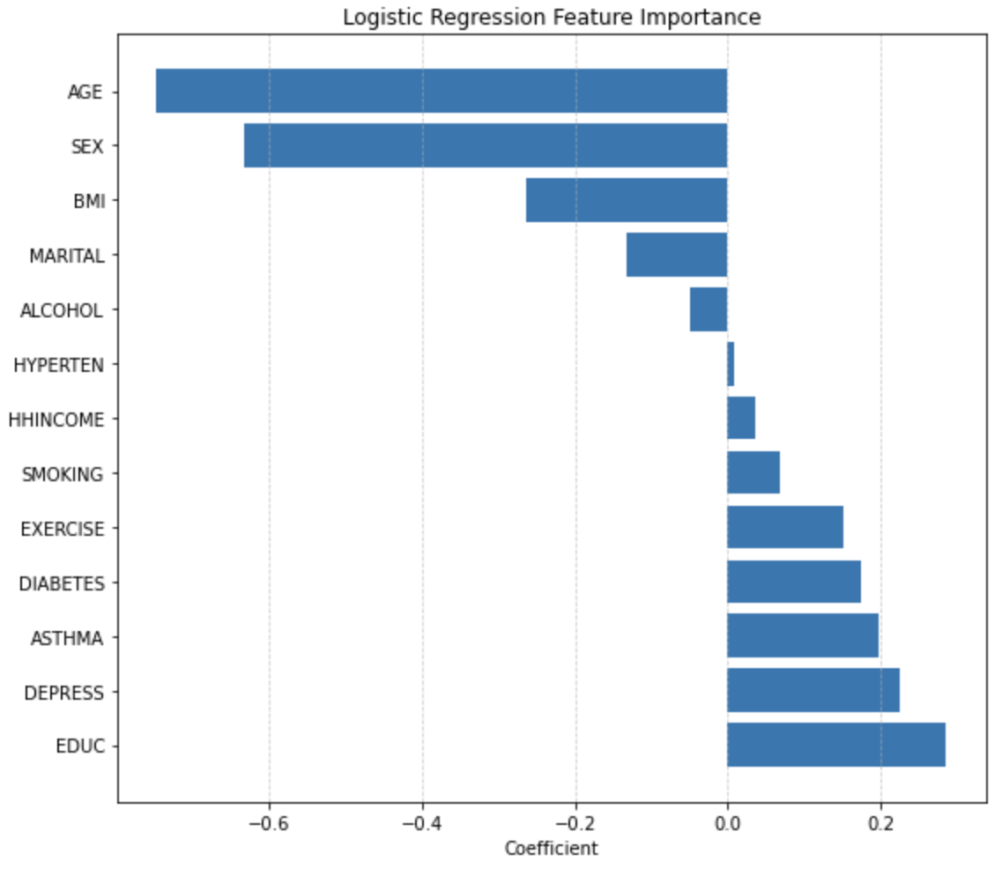
Logistic Regression
Predicts high vs. low SRH
Positive coefficients are associated with higher SRH, negative is associated with lower SRH
Accuracy = 0.73, AUC = 0.78 (model distinguishes high vs. low SRH)
strong predictive performance
Education and physical activity are associated with higher SRH
Depression, asthma, diabetes, and smoking predict lower SRH
Notes:
Population-level SRH prediction
Interpretable coefficients
Education, exercise protective
Chronic conditions harmful
Environmental effects comparable to biological
Hyperparameters:
Penalty: “elasticnet”
Solver: “saga”
Required for elasticnet
L1 ratio: 0.5
Equal mix of L1 and L2
Class weight: “balanced”
Max iterations: 5000

Slide 16
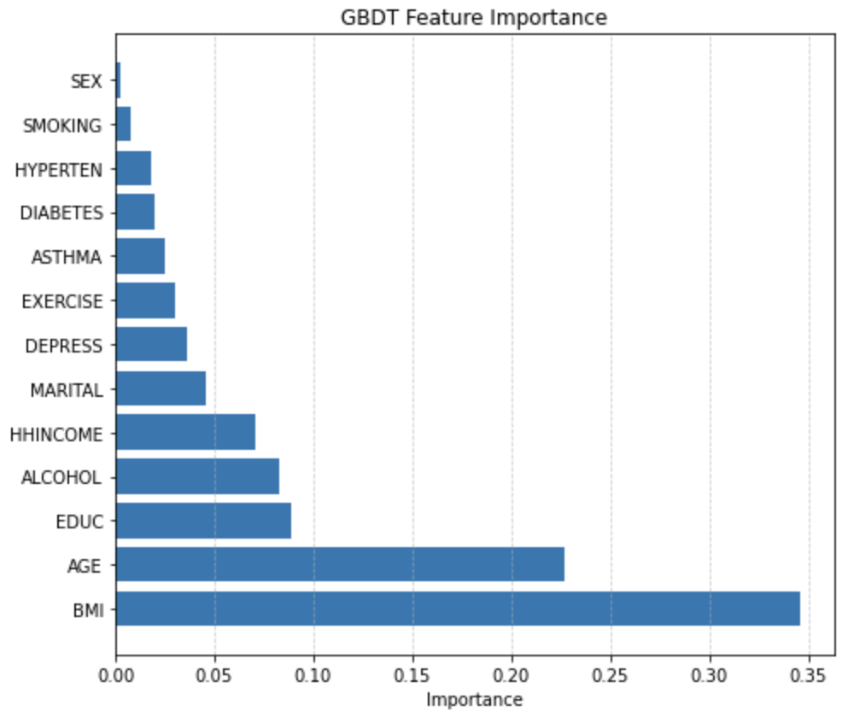
Gradient Boosted Decision Trees
Nonlinear model applied to population level SRH prediction
Performance similar to logistic regression (Accuracy = 0.79, AUC = 0.75)
BMI and Age are most influential predictors under nonlinear modeling
Education and Alcohol use retained meaningful predictive effects
Minimal gain from GBDT relationships are mostly linear
Notes:
Allows nonlinear relationships
Similar performance to logistic model
Age and BMI dominate importance
Environmental predictors persist
Limited complex interactions detected
Hyperparameters:
Number of trees: 300
Learning rate: 0.05
Smaller steps -> more stable learning
Max depth: 3
Shallow trees to prevent overfitting
Subsample: 0.8
Stochastic gradient boosting

Slide 17
Longitudinal Modeling
Goal: Understand how self rated health changes over adulthood
Modeling frameworks:
Mixed Effects Longitudinal Model accounts for repeated health measurements over time
Baseline differences:
Family-Level Intercept: shared starting health within twin pairs
Individual-Level Intercept: personal health starting point
Identifies whether biological burden or environmental conditions explain health changes over time
Notes:
Repeated observations per individual
Random intercepts for family + person
Separates baseline from change
Accounts for dependency in data
Focus on variance decomposition

Slide 18
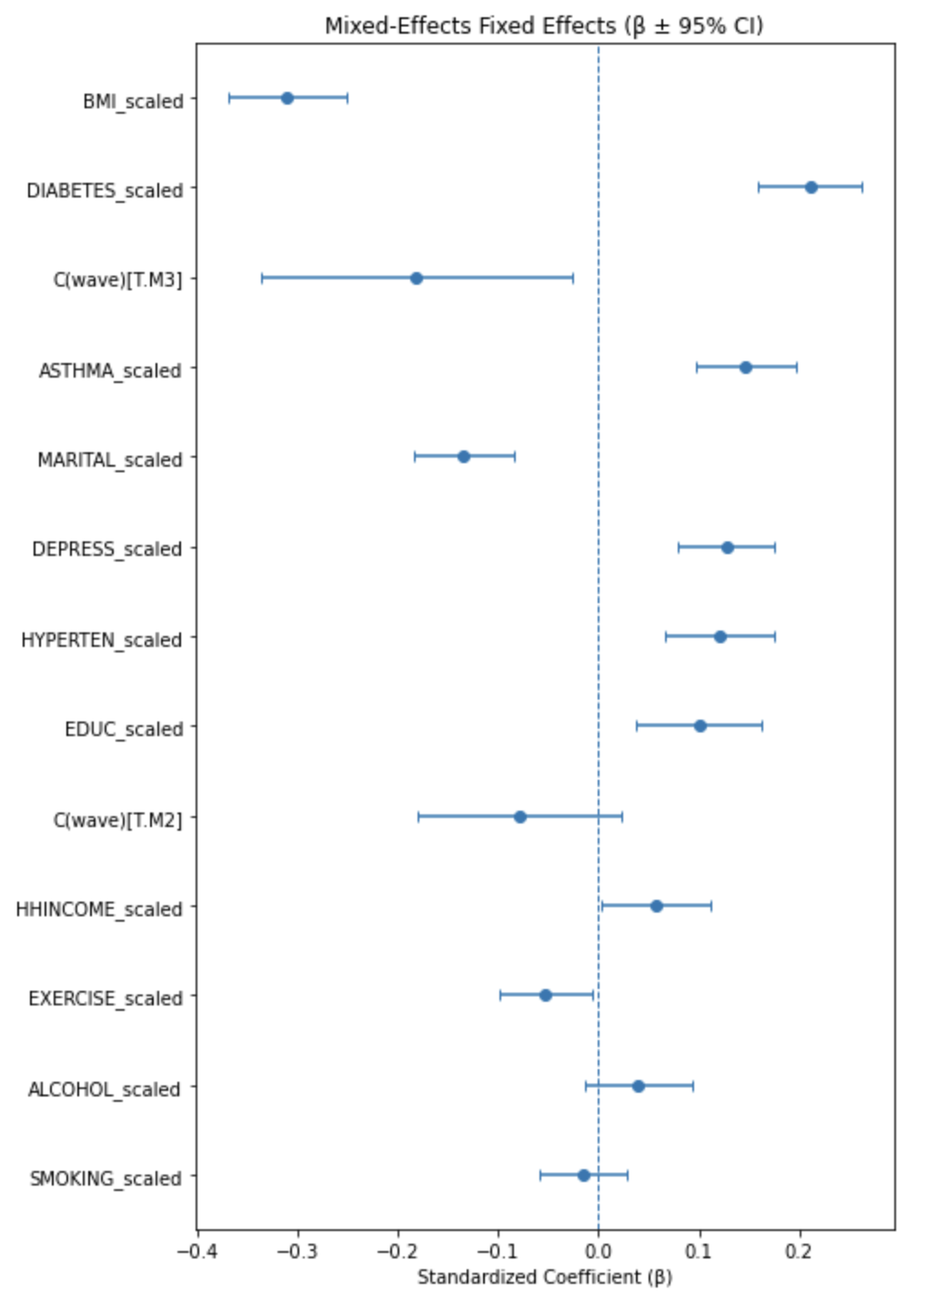
Longitudinal Fixed Effects
Shows how predictors relate to SRH over time, after accounting for each wave
> 0: SRH increases as variable increases
< 0: SRH decreases as variable increases
Higher BMI is consistently linked to worse SRH across adulthood
Education, income, and exercise are associated with better SRH trajectories
Wave terms show how average SRH changes over time
Notes:
What the Longitudinal Model Is Doing
Follows the same individuals across MIDUS waves (M1, M2, M3)
Uses all time points at once, not separately
Allows each family to have its own baseline health level and allows each individual to have their own baseline health level
Measures how self-rated health changes over time, not just differences between people
Separates aging effects (wave) from predictor effects (biology and environment)
What the Results Mean
Self-rated health declines over time on average (negative wave effects)
Biological burden (higher BMI, diabetes, depression) is linked to worse health across adulthood
Environmental and behavioral factors (education, income, exercise) are linked to better health trajectories
Even after accounting for shared family background, environmental factors still matter
Health differences among similar individuals emerge and grow over time

Slide 19
Discussion
Biology provides a shared baseline of health among twins
Environmental factors show greater variability and stronger predictive influence
Unsupervised learning revealed greater divergence in environmental space
Supervised learning confirmed higher predictive value of environmental exposures
Longitudinal modeling showed environmental effects accumulate across adulthood
Notes:
Biology sets starting point
Environment shapes divergence
Unsupervised + supervised agree
Longitudinal confirms persistence
Results align with theory

Slide 20

Implications
Health trajectories are modifiable, biology sets baseline risk, but environmental conditions drive divergence over time
Environmental and behavioral interventions can meaningfully improve health outcomes even among individuals with shared biological risk
Policies targeting education, income stability, stress reduction, and health behaviors are critical for reducing long-term health disparities
Notes:
Health not genetically predetermined
Modifiable factors matter
Prevention over treatment framing
Policy relevance
ML helps identify leverage points

Slide 21

Future Directions
Incorporate zygosity information to refine genetic vs. environmental partitioning
Add clinic based biomarkers to track physiological aging
Evaluate time period sensitivity: When do environmental effects matter most?
Compare results to non-twin population datasets to assess generalizability
Notes:
Incorporate zygosity explicitly
Add objective biomarkers
Explore sensitive periods
Causal ML approaches
Generalize beyond twins

Slide 22

Conclusion
Biological traits shape initial health status, but do not dictate outcomes
Environmental and behavioral factors play a major role in adult self rated health variation
Divergence in self rated health between genetically similar individuals is environmentally driven
Machine learning approaches provided converging evidence across models
Notes:
Shared biology ≠ identical outcomes
Environment dominates adult variation
Divergence increases with age
Multiple models converge
Strong life-course evidence

